Slide 1
Object Oriented Implementation

Slide 2
Object Oriented Implementation
With the completion of interaction diagrams & DCDs, there is sufficient detail to generate code for domain layer of objects.
The UML artifacts created during the design work(Interaction diagram & DCD) will be used as input to the code generation process.
The implementation Model in UP contains the implementation artifacts such as source code, database definition, JSP/XML/HTML pages, &so forth.
Having wrapped up with design issues with visibility, this chapter introduces mapping of design to code in OO language.

Slide 3
Programming & Development Process
There is prototyping or design while programming as well!!
Modern development tools provide an excellent environment to quickly explore alternative approaches, & some design -while programming is usually worthwhile.
Visual modeling before programming is helpful
The creation of code in an object-oriented programming language—such as Java or C#—is not part of OOA/D;
it is an end goal.
The artifacts created in the UP Design Model provide some of the information necessary to generate the code.
A strength of OOA/D and OO programming—when used with the UP—is that they provide an end-to-end roadmap from requirements through to code.

Slide 4
Creativity & change during implementation
Some decision-making and creative work was accomplished during design work.
However, in general, the programming work is not a trivial code generation step- quite the opposite.
Realistically, the results generated during design are incomplete first step; during programming and testing, numerous changes will be made and detailed problems will be uncovered and resolved.
Done well, the ideas & understanding are generated during OOD modeling will provide a great base that scales up with elegance and robustness to meet the new problems encountered during programming.
Consequently, expect and plan for change and deviation from the design during programming.

Slide 5
Codes changes & the iterative process
A strength of iterative & incremental development process:
  Is that the result of a prior iteration can feed into beginning of next iteration.
Thus, subsequent analysis & design results are continuously being refined & enhanced from prior implementation work.

Slide 6
Codes changes & the iterative process
For example,
when the code in iteration N ,deviates from the design of iteration N (which it inevitably will),
  the final design based on the implementation
  can be input to the analysis and design models of iteration N+l.
An early activity within an iteration is to synchronize the design diagrams;
The earlier diagrams of iteration N will not match the final code of iteration N, and they need to be synchronized before being extended with new design results.

Slide 7
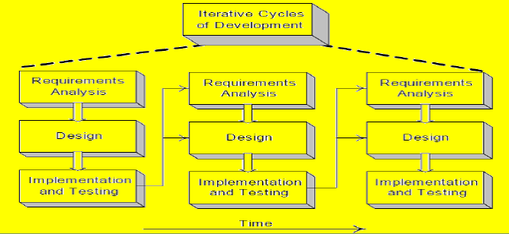
Iterative cycles of development

Slide 8
Code Changes, CASE Tools, and Reverse-Engineering
It is desirable for the diagrams generated during design to be semi-automatically updated to reflect changes in the subsequent coding work.
Ideally this should be done with a CASE tool
  that can read source code and
  automatically generate, for example, package, class, and sequence diagrams.
This is an aspect of reverse-engineering—the activity of generating diagrams from source (or sometimes, executable) code.

Slide 9
Mapping Design to code
With the completion of interaction diagram & DCD,
One can start generation of code where in the interaction diagram & DCD can be used as the input.
Implementation of OO language requires writing source code for:
  Class & interface definitions
  Method definitions

Slide 10
Creating class definitions from DCDs
At the very least, DCDs depict the class or interface name, superclasses, operation signatures, and attributes of a class.
This is sufficient to create a basic class definition in an OO language.
If the DCD was drawn in a UML tool, it can generate the basic class definition from the diagrams.

Slide 11
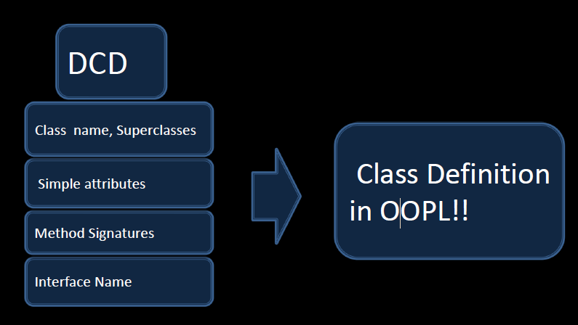

Slide 12
Defining a Class with Methods and Simple Attributes
From the DCD,
a mapping to the attribute definitions(java fields) and
method signatures for the Java definition of SalesLineItem is straightforward as shown in fig below.
The create method is often excluded from the class diagram because of its commonality and multiple interpretations, depending on the target language.

Slide 13
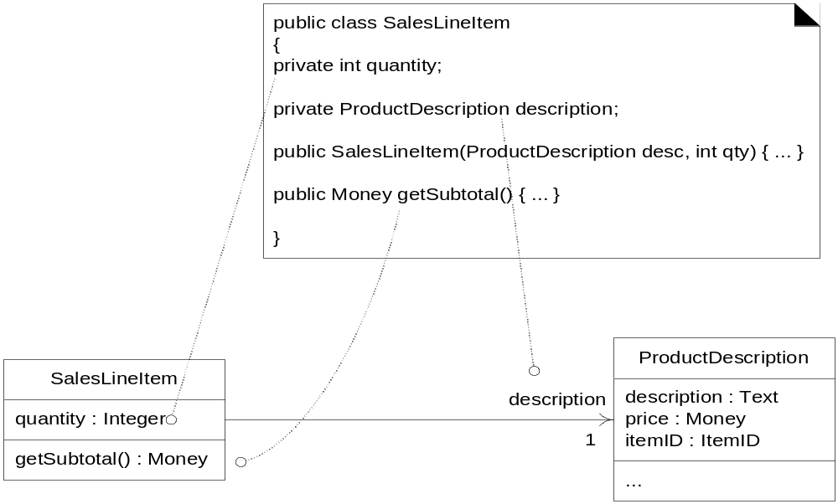
From DCD to Java class

Slide 14
Creating Methods from Interaction Diagrams
The sequence of messages in the interaction diagram translates to a series of statements in the method definitions
The enterltem interaction diagram in fig below illustrates the Java definition of the enterltem method.

Slide 15
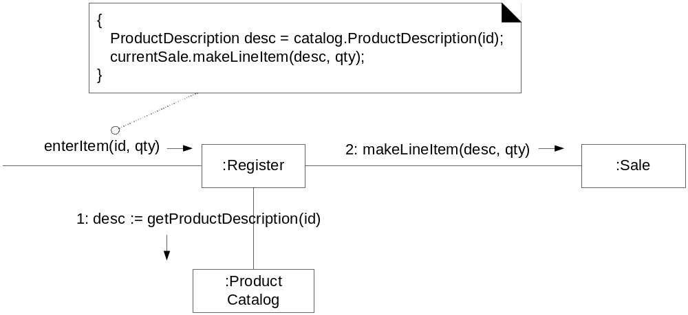
From Interaction diagram to method

Slide 16
Creating Methods from Interaction Diagrams contd…
For this example we will explore the implementation of the Register & its enterItem method.
A Java definition of Register class is shown below
The enterltem message is sent to a Register instance; therefore, the enterltem method is defined in class Register.
public void enterltem( ItemID itemID, int qty);

Slide 17
Message 1: A getProductDescription message is sent to the ProductCatalog to retrieve ProductDescription.
ProductDescription desc =catalog.getProductDescription(itemID);
Message 2:The makeLineItem message is sent to Sale
currentSale.makeLineItem(desc, qty);
Each sequenced message within a method, shown in the interaction diagram, is mapped to the statement in Java method
The complete enterItem method & its relationship to the interaction diagram is shown below.

Slide 18
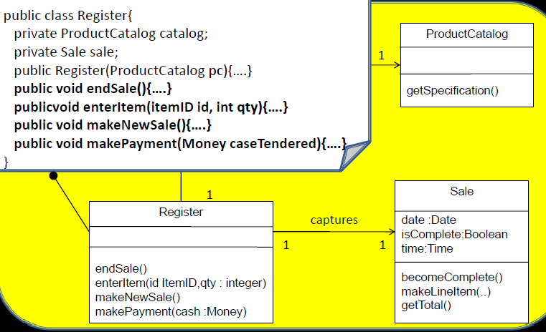
The Register.enterItem method

Slide 19
Creating class definitions from DCDs
Message 1:
A getSpecification message is sent to the ProductCatalog to retrieve a ProductSpecification.
ProductSpecification spec = catalog. getSpecification( itemID);
Message 2:
The makeLineltem message is sent to the Sale.
sale .makeLineltem(spec, qty);
In summary, each sequenced message within a method, as shown on the interaction diagram, is mapped to a statement in the Java method.

Slide 20
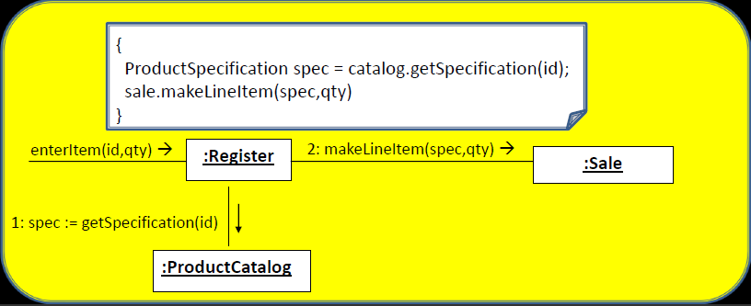
The enterItem method

Slide 21
Collection Classes in Code
One to may relationships are common
For example, a Sale must maintain visibility to a group of many SaleLineItem instances
In OO programming languages, these relationships are often implemented with the introduction of intermediate container or collection object.
One side class defines reference attributes pointing to a container/collection instance, which contains instances of many side classes.
Private List LineItems= new ArrayList();

Slide 22
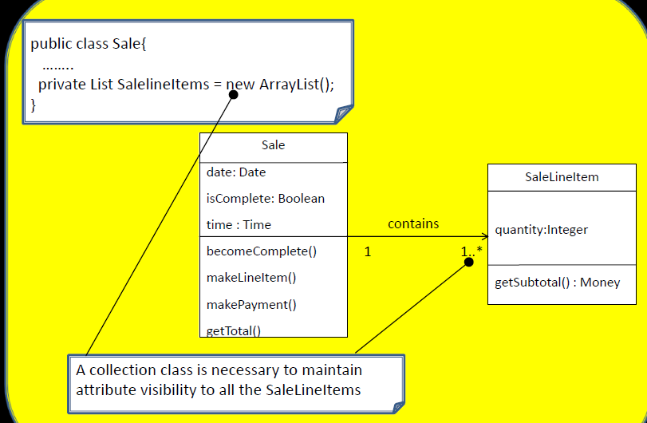
Adding a collection

Slide 23
Exceptions & Error Handling
It wise to consider large-scale exception handling strategies during
  design modeling as they have a large architectural impact &
  certainly during implementation
In UML, exceptions can be inserted as property strings of messages & operation declarations.

Slide 24
Ordering of Implementation(Classes)
Classes need to be from least-coupled to most-coupled
For example, possible first classes to implement are either Payment or ProductDescription; next are classes only dependent on the prior implementations—ProductCatalog or SalesLineItem

Slide 25
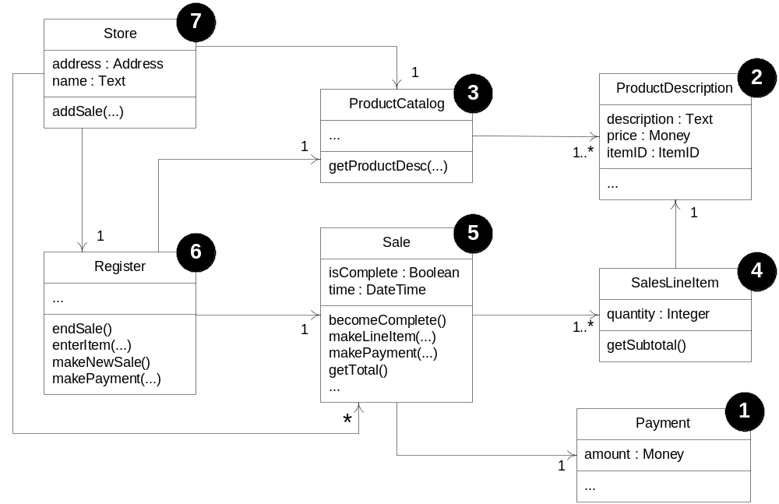
Order of Class Implementation

Slide 26
Defining the Sale—makeLineltem Method
As a final example, the makeLineltem method of class Sale can also be written by inspecting the enterltem collaboration diagram.

Slide 27
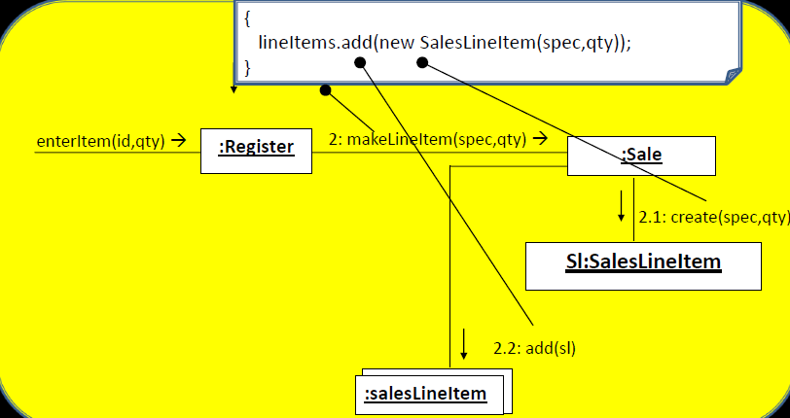
Fig-Sale.makeLineItem method

